Slide 1

Studies in Computer Science?
Dr. George Mertzios
School of Engineering and Computing Sciences
Durham University, UK
1

Slide 2

Main Questions
What is Durham University ?
What is Computer Science (CS) ?
Why should I study CS at Durham ?
2

Slide 3
What is Durham University?
3rd oldest university in England (1832)
after Oxford and Cambridge
Top ranked university:
5th in The Complete University Guide 2015
6th in The Times & The Sunday Times Good University Guide 2015
World Top 25 for employer reputation:
QS World University Rankings 2014
regarding the quality & international demand for its graduates
3

Slide 4
What is Durham University?
A unique College system:
16 Colleges
every student is a member of a College
accommodation, sports, socializing & more
strongly connected communities, offering a great network after graduation
https://www.dur.ac.uk/tour/colleges/
4

Slide 5
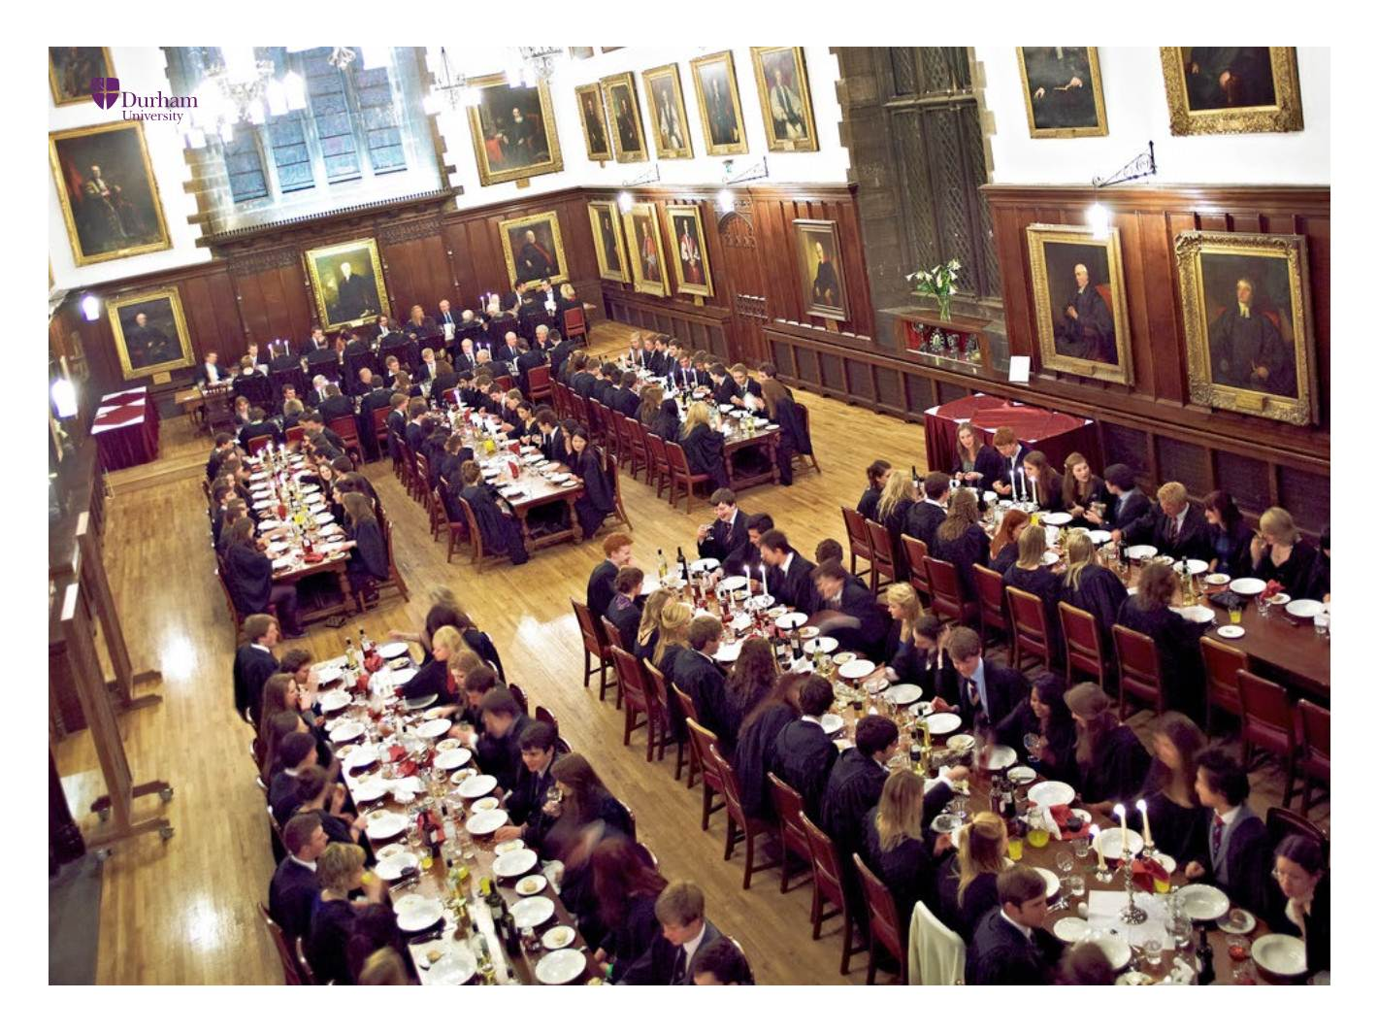



What is Durham University?
5

Slide 6
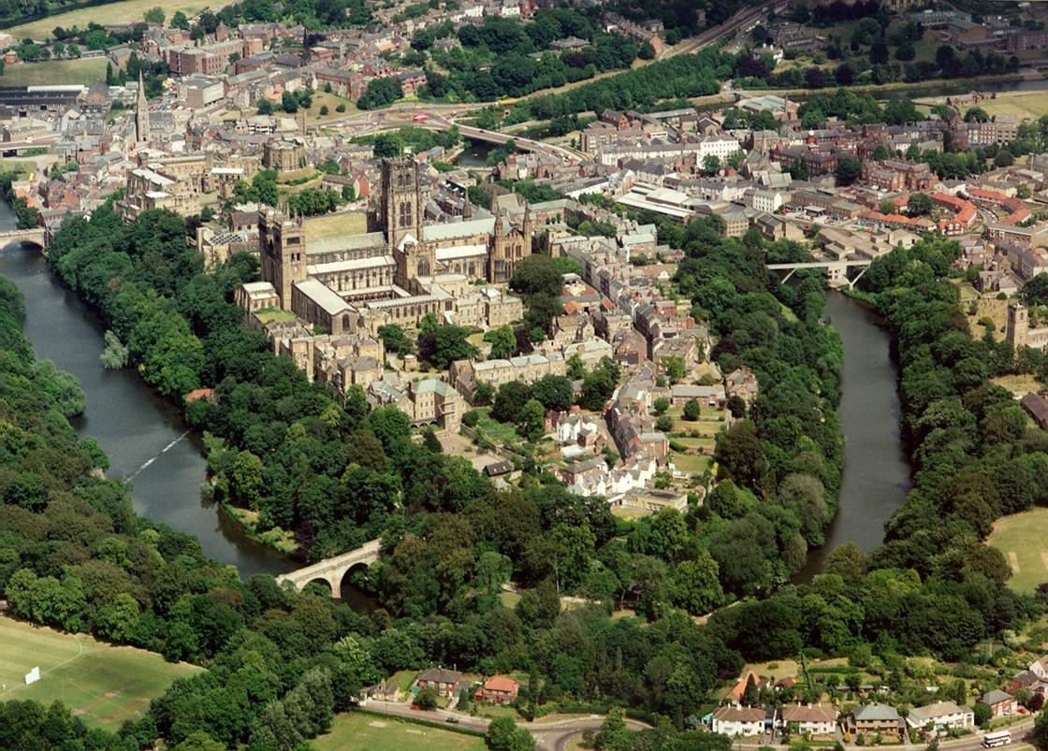
What about Durham city?
A beautiful ancient town in the North-East:
6

Slide 7
What about Durham city?
A beautiful ancient town in the North-East:
13 minutes to Newcastle
2 hours to Edinburgh
3 hours to London
Mostly a student city:
more than 15.000 students from 150 countries
a lot of student cafés / pubs / party places
One of the most safe cities in England
Very cheap housing (and beer):
estimated £ 7.850 annual living costs (see here)
7

Slide 8



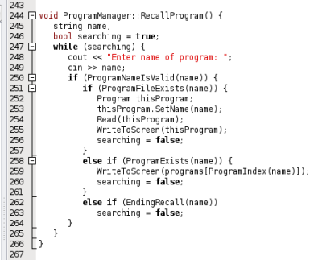



What is Computer Science?
users | engineers / administrators | designers
8

Slide 9
What is Computer Science?
Design of architectures for PCs / laptops, micro-processors, mobile devices, storage media (hard disks, CDs), …
Verify the correctness of the design
are all computations provably correct?
Design efficient processes (algorithms) for specific computational tasks
must be both fast and correct !
9

Slide 10


Challenges in algorithm design
From very practical applications
programming (writing code in Java, C++, …)
software engineering
To highly theoretical (but applicable!) tasks
how to schedule cargo ships to minimize costs?
how to find quickly the best route from street A to street B ?
10

Slide 11
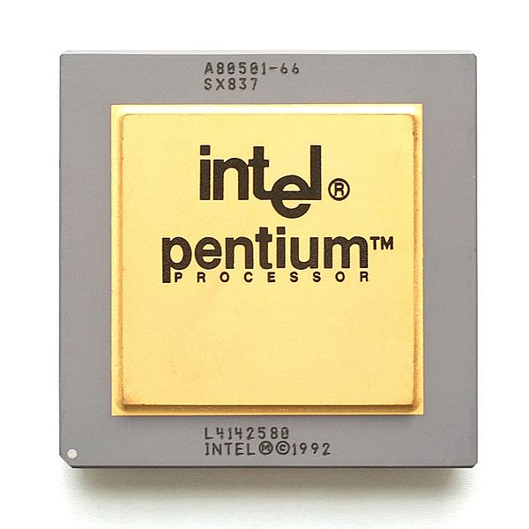
Challenges in algorithm testing
1993: Intel introduced processor Pentium P5
1994: A mathematics professor (Thomas Nicely) detects some incorrect computations of P5
the design was not properly tested !
Customers stopped trusting Intel
1995: Intel announced $475 million loss
defective processors became key rings
11

Slide 12
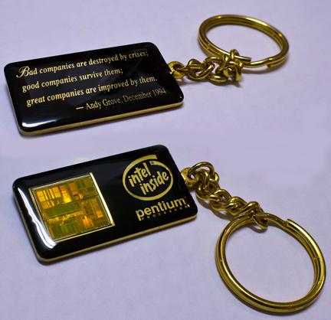
Challenges in algorithm testing
12

Slide 13
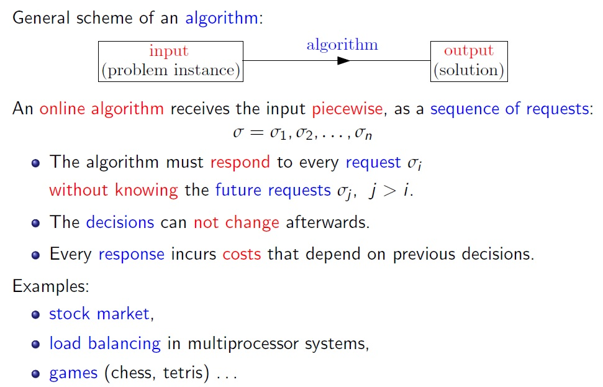
Online Algorithms
input
(problem instance)
output
(solution)
13

Slide 14
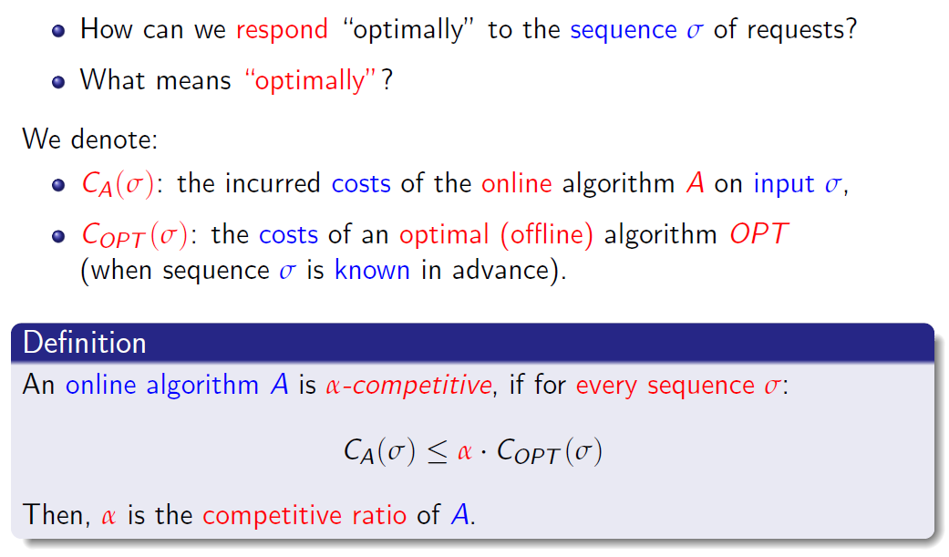
Online Algorithms
14

Slide 15





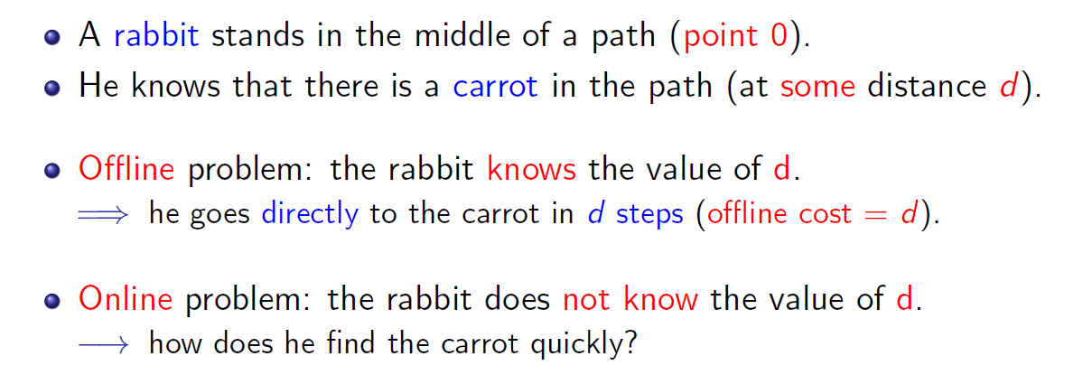
Online Algorithms
15

Slide 16
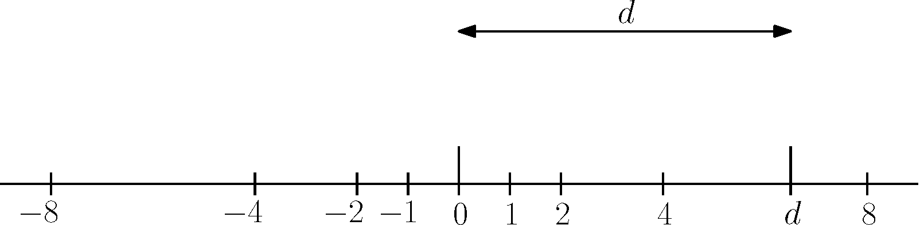
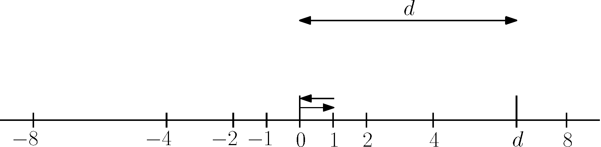
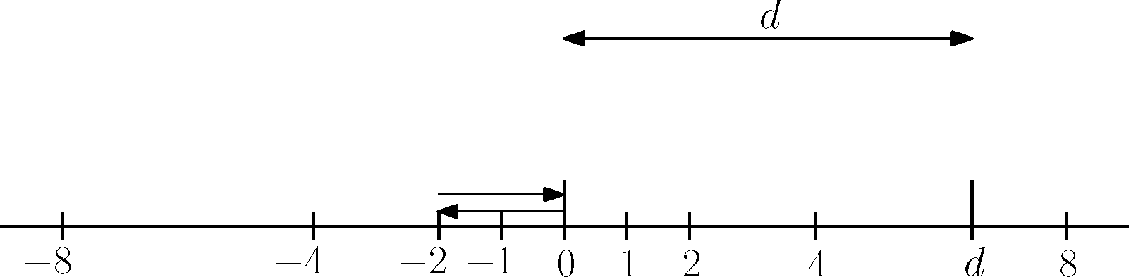
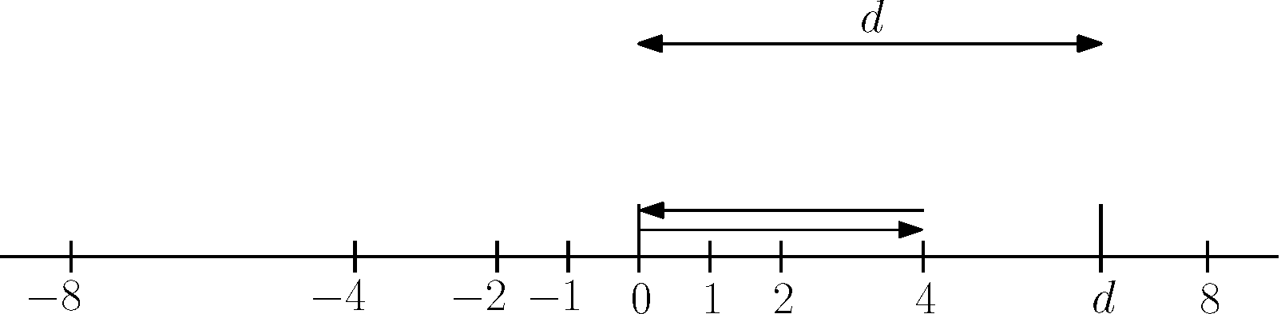
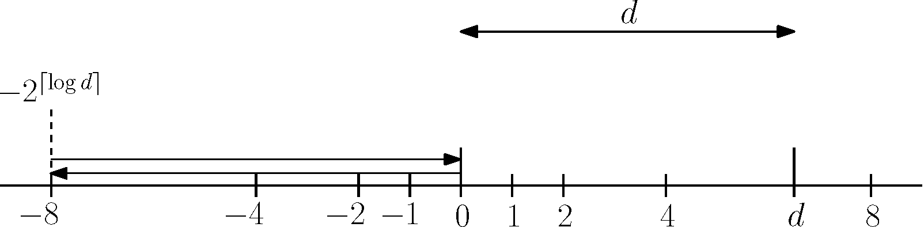
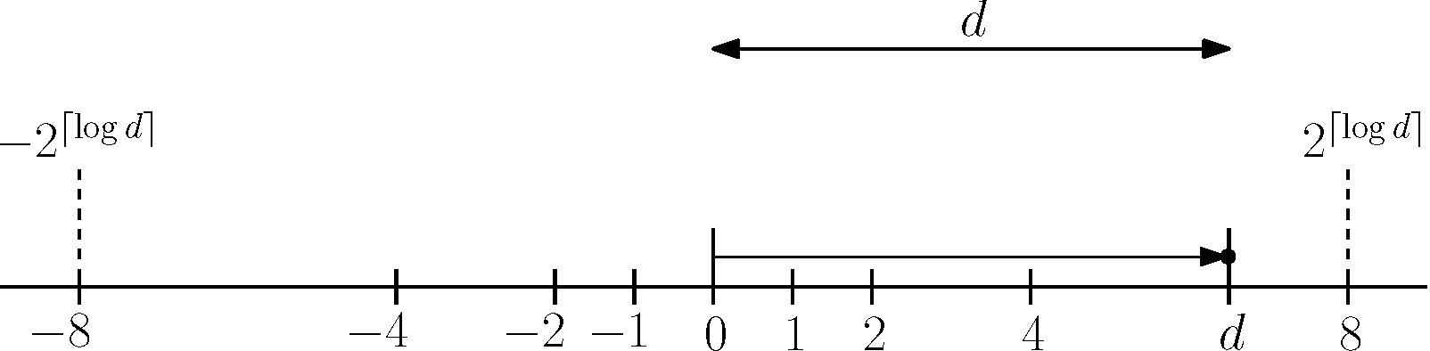
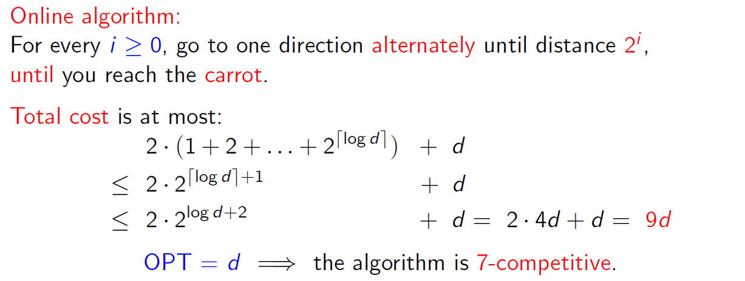
Online Algorithms
16

Slide 17
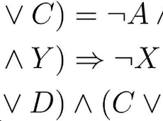
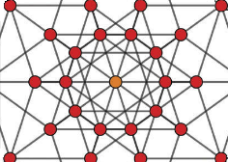


Why CS at Durham ?
Computer Science at Durham is top ranked:
5th in The Complete University Guide 2015
One of the world leading research centers:
Graph Theory & Applications
Theoretical
Computer Science
Graphics & Image
Processing
High Performance Computing
17

Slide 18
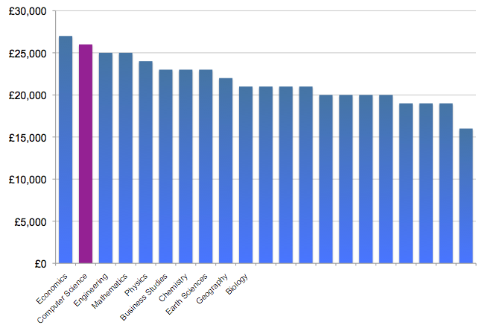

Why CS at Durham ?
Durham CS graduates get great jobs:
Average salary for Durham CS graduates is higher than (almost) all other subjects
Source: DLHE survey of leavers
18

Slide 19
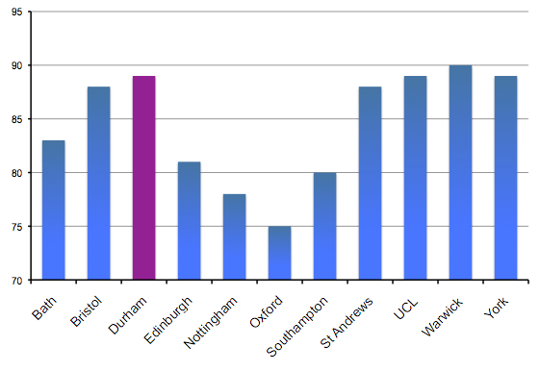
Why CS at Durham ?
Computer Science Graduate Prospects:
Source: Complete University Guide 2014
19

Slide 20
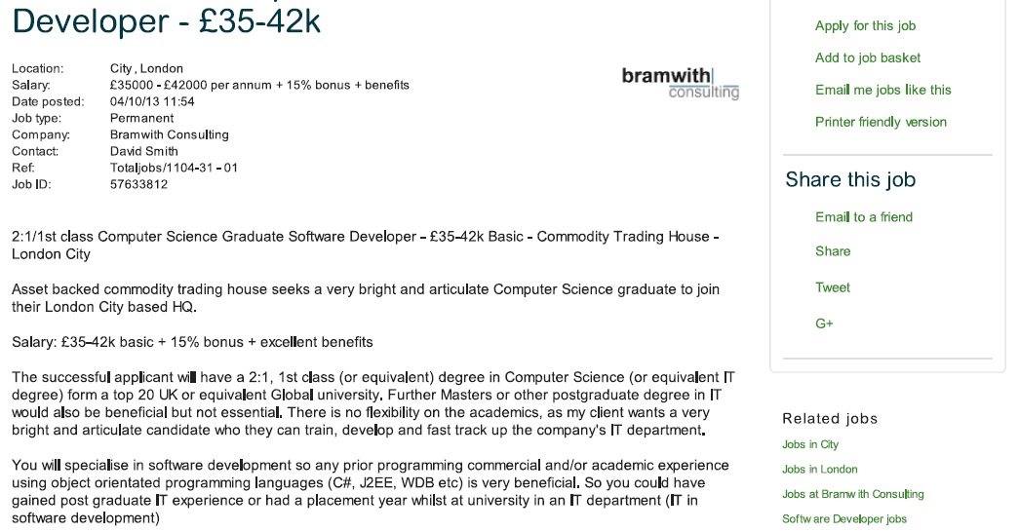
Job examples
From: www.cwjobs.co.uk
20

Slide 21
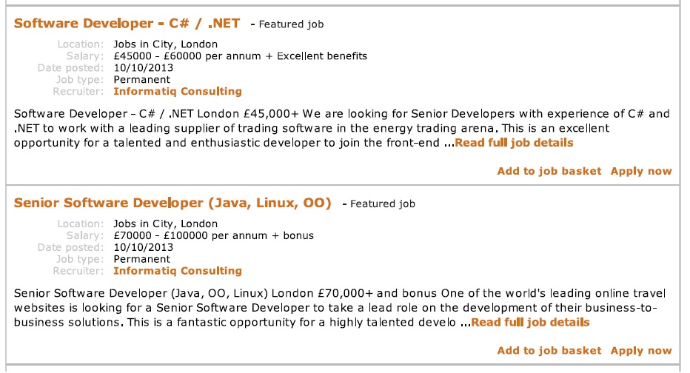
Job examples
From: www.cwjobs.co.uk
21

Slide 22
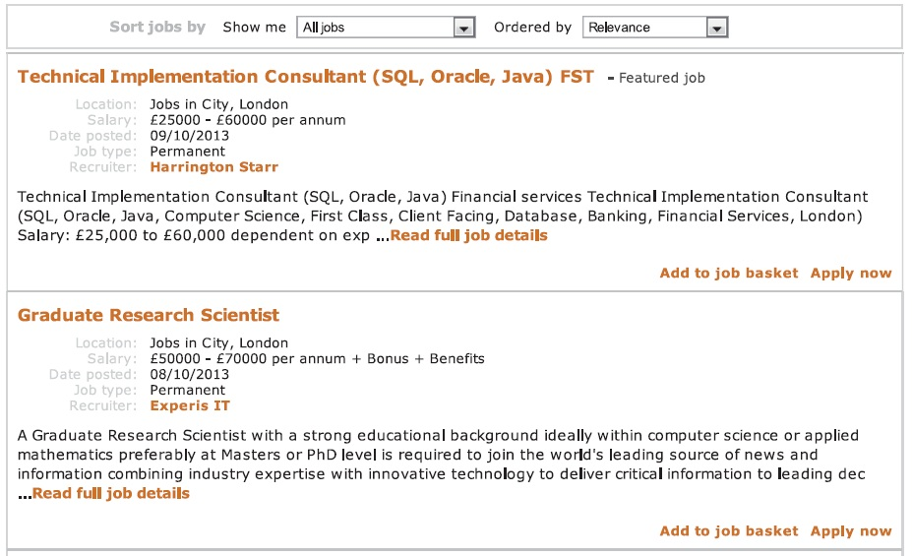
Job examples
From: www.cwjobs.co.uk
22

Slide 23
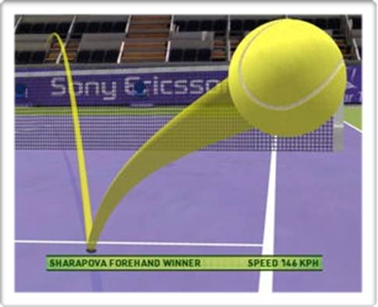
Hawk-Eye: a story of success
used officially in many sports (cricket, tennis, …)
Inventor: Paul Hawkins CS Durham graduate (2001)
23

Slide 24

Durham CS graduates get great jobs
Companies approach us asking for our graduates
24

Slide 25





Durham CS graduates get great jobs
We have long industrial relationships offering excellent internship opportunities
Performance through technology
25

Slide 26












Durham CS graduates get great jobs
26
DLHE survey of leavers

Slide 27














Durham CS graduates get great jobs
27
DLHE survey of leavers

Slide 28














Durham CS graduates get great jobs
Raindrop Information Systems
28
DLHE survey of leavers

